Slide 1

7023T
Advanced Database Systems
Session 04
Collecting the Requirements
This presentation is based on Michael A. Fudge, Jr.

Slide 2
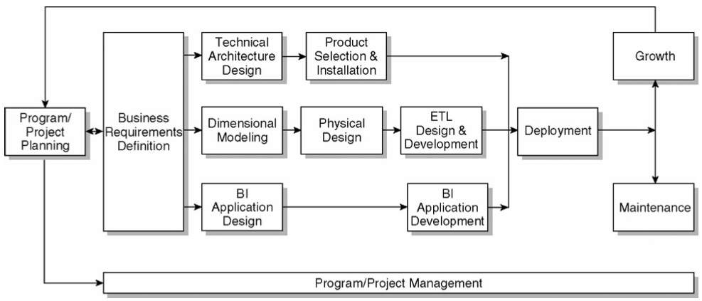
The Kimball Lifecycle Diagram

Slide 3
Some Kimball Terminology
Program – Collection of coordinated projects
Several Data marts will be created.
Ex. Sales BI program: Build data marts for internet sales, store sales, and partner sales.
Project – Single iteration of the entire cycle.
Encompasses a business process which results in a data mart.
Ex. Build a data mart for internet sales
Notes:
One important concept from your readings this week is the difference between a project and a program.
[Read slide]
This program / project terminology is why some datawarehouse professionals consider
Kimball’s approach to be “bottom up” and
Inmon’s approach is “top down”
Kimball starts with a single project and iterates over the lifecycle until the entire program or initiative is built. Over time you will build out all the components and implement the BI toolset to complete the program.
Inmonfavors, having everything in place prior to implementing a project. This helps maximize success and limit situations where the project is delayed due to lack of a specific infrastructure component.

Slide 4
The Relationships between: Programs, Projects, and Data Marts.
Contains one or more…
Implemented as one or more…
Program
Project
Data Mart
Each project team will work on one project within the same program.

Slide 5
Is Your Organization Prepared To Take This On?
First you must assess your organization’s readiness:
Do you have strong support from upper management?
Is there a compelling business motivation behind the initiative ?
It is technically feasible with the resources and data you’re given?
Your answer to these questions should be
YES
Notes:
Kimball make it clear that one of the first questions you need to ask is whether your org. is prepared to take on this initiative? Whether you’re building out a data mart or an entire DW/BI solution, you must first asses readiness.

Slide 6
Activity: Choose a project
TODO:
Remember: you’re all working on the same program.
Each of you needs to identify a project you will work on, based on the data in ExternalSources
Each group should select a different project.
Group | Project
A
B
C
D
E
F
G
H

Slide 7
Planning Activities
The Charter
Define the project background
Set project scope and boundaries (what’s excluded).
Identify success criteria for the project
State the business justification
Assemble the Project Team (at minimum)
Business Lead - In charge of initiative
Project Manager – Manages project
Business Analyst – Collects requirements
Data Architect – Dimensional Modeling / Implementation
ETL Architect – ETL Design / Implementation
BI Architect - BI Design / Implementation
Notes:
Part of planning out a project or initiative is to establish a charter this should:
Next you should assemble the project team this will contain a mix of individuals with a variety of skillsets.

Slide 8
Group Activity: Charter and team
TODO:
Write up your charter for the chosen group project.
Select primary roles for each team member.
Each team member should have 2 roles.
The Charter
Define the project background
Set project scope and boundaries (what’s excluded).
Identify success criteria for the project
State the business justification
The Project Team
Business Lead - In charge of initiative
Project Manager – Manages project
Business Analyst – Collects requirements
Data Architect – Dimensional Modeling / Implementation
ETL Architect – ETL Design / Implementation
BI Architect - BI Design / Implementation

Slide 9
Planning Activities
Establish a Communication Plan
How will you keep stakeholders informed?
How often and in what form will you meet?
Who needs to be present at which meetings?
Create your Project Plan and Task List
Track issues using a change log or issue tracking system.
Hold a Kickoff meeting to get everyone on the same page.
Notes:
The communication plan helps establish the time commitments of project members as sets expectations as to how and how often you will communicate.
The issue tracking system is important because you’re not going to have all the answers at the time you raise the question. It’s important to log issues so they can be addressed by members of the team.
After the other planning activities are fleshed out you should hold a kickoff meeting to communicate your charter, project plan, procedures, and next steps.

Slide 10
Key Activities of Requirements Gathering
Interviews with business users.
Data Audits – data profiling to assess capabilities of data sources.
Documentation, including
Interview Write-ups
Identify Business Processes
Enterprise Bus Matrix
Prioritization Grid
Issues List
Notes:
As Part of the project plan you should expect to hold interviews with the people who will benefit from your initiative. Remember you’re not a mind-reader and you probably don’t have a photographic memory so you’ll need to engage users and also take really good notes. If you plan to record the interview, make sure the interviewee (and your organization) is okay with doing that.
Through interviews should be able to get information on sources of data. You must gather information regarding the format and condition of the source data. We call this data auditing / data profiling. Here you should be assessing the candidacy of the source data and determine how much data clean-up will need to take place. Its important to track issues using your issues list or issue tracking system.
The end of these activities should be documentation, including:

Slide 11
Sample Interview Questions
What type of routine analysis do you perform? What data is used and where do you get it? What do you do with the data once you get it?
Which reports do you use? Which data on the report is important? If the report were dynamic what would it do differently?
Describe your products. How do you distinguish different products? How are they categorized? Do categories change over time?
Notes:
When you interview business users, you need to ask questions regarding how the they acquire, use, and derive value from data. It is important to communicate in terms they understand and leave the technical jargon out of it.
You should ask about existing reports, any additional processing the users perform on the data and ask about the key entities which are part of their process.

Slide 12
Data Profiling
One important activity is to explore your existing data to get a sense of
Technical feasibility of the project
Structure and condition of data
Availability of Data Sources
We call this Data Profiling
If the source data is in a relational database, you can use the SQL SELECT statement to profile data.
For other sources, Microsoft Excel makes for a good data profiling tool.
Notes:
Data profiling involved exploring source data to get a sense of its current : (read list)
Sometimes you might need to extract raw data from its source like a mainframe or midrange system into a relational database or spreadsheet so that you can profile the data more thoroughly.
Data profiling might raise additional questions about the use and meaning of the data your profiling. As such you might need to conduct brief follow-up interviews with users or research an organizations technical documentation, such as data dictionaries (should they exist).

Slide 13
Data Profiling Example
You can use tools like Excel to profile your data, searching for useful dimensions and facts.
By Year
Total Sales
By Country
Notes:
Here’s an example of profiling. You can profile any data that is useful to the user. It can be in an existing report, or at the data’s source. On advantage of using the source is you can help asses future ETL requirements and uncover existing dimensional attributes. Like perhaps adjusting the existing report to allow exploration of sales by year then quarter then month or by sales region and then individual country.

Slide 14
Critical Skill: Turn business processes into dimensional models!
Here’s the process for building a dimensional model from a business process. This dimensional model will eventually become a star schema in your enterprise data warehouse.
Identify the business process and business process type.
Identify the facts of the business processes.
Identify the dimensions of the business process.

Slide 15


Example
Business User Says:
“I need to know: How many sneakers did we sell last week?”
What I hear
Quantity (Fact)
Product Type (Attribute of a Product Dimension)
Business
Process (Sales)
Duration of Time (Attribute of a Sales Date Dimension)
Facts are the business process measurement events
Dimensions provide the context for that event.

Slide 16
#1: Identifying Business Processes 3 types:
Events or Transactions
Workflows a.k.a. Accumulating Snapshots
Points in time a.k.a Periodic Snapshots
Business processes contain facts which we use end up being the fact tables in our ROLAP star schemas.
Transaction
Accumulating Snapshot
Periodic Snapshot

Slide 17
Transaction Fact
The most basic fact grain
One row per line in a transaction
Corresponds to a point in space and time
Once inserted, it is not revisited for update
Rows inserted into fact table when transaction or event occurs
Examples:
Sales, Returns, Telemarketing, Registration Events

Slide 18
Accumulating Snapshot Fact
Less frequently used, application specific.
Used to capture a business process workflow.
Fact row is initially inserted, then updated as milestones occur
Fact table has multiple date FK that correspond to each milestone
Special facts: milestone counters and lag facts for length of time between milestones
Examples:
Order fulfillment, Job Applicant tracking, Rental Cars

Slide 19
Periodic Snapshot Fact
At predetermined intervals snapshots of the same level of details are taken and stacked consecutively in the fact table
Snapshots can be taken daily, weekly, monthly, hourly, etc…
Complements detailed transaction facts but does not replace them
Share the same conformed dimensions but has less dimensions
Examples:
Financial reports, Bank account values, Semester class schedules, Daily classroom Lab Logins, Student GPAs

Slide 20
Group Activity: Which Fact Table Grain?
Concert ticket purchases?
Voter exit polls in an election?
Mortgage loan application and approval?
Auditing software use in a computer lab?
Daily summaries of visitors to websites?
Tracking Law School applications?
Attendance at sporting events?
Admissions to sporting events at 15 minute intervals?
Transaction
Accumulating Snapshot
Periodic Snapshot

Slide 21
Answers: Which Fact Table Grain?
Concert ticket purchases? T
Voter exit polls in an election? T
Mortgage loan application and approval? AS
Auditing software use in a computer lab? T
Daily summaries of visitors to websites? PS
Tracking Law School applications? AS
Attendance at sporting events? T
Admissions to sporting events at 15 minute intervals? PS
Transaction
Accumulating Snapshot
Periodic Snapshot

Slide 22
#2 Identify the facts of the business process.
Facts are quantifiable numerical values associated with the business process.
How much?
How many?
How long?
How often?
If its not tied to the business process, its not a fact.
For example:
Points Scored == Fact, Player He

Slide 23
3 Types of Facts
Additive - Fact can be summed across all dimensions.
The most useful kind of fact.
Quantity sold, hours billed.
Semi-Additive - Cannot be summed across all dimensions, such as time periods.
Sometime these are averaged across the time dimension.
Quantity on Hand, Time logged on to computer.
Non-Additive - Cannot be summed across any dimension.
These do not belong in the fact table, but with the dimension.
Basketball player height, Retail Price

Slide 24
Group Activity: Facts or Not?? Additive? Semi? Non?
Number of page views on a website?
The amount of taxes withheld on an employee’s weekly paycheck?
Credit card balance.
Pants waist size? 32, 34, etc…
Tracking when a student attends class?
Product Retail Price?
Vehicle’s MPG rating?
The number of minutes late employees arrive to work each day.

Slide 25
Answers: Facts or Not? Additive? Semi? Non?
Number of page views on a website? F/A
The amount of taxes withheld on an employee’s weekly paycheck? F/A
Credit card balance. F/S
Pants waist size? 32, 34, etc… N/A
Tracking when a student attends class? F/A
Product Retail Price? N/A
Vehicle’s MPG rating? N/A
The number of minutes late employees arrive to work each day. F/A
Notes:
1. Fact, Additive
2. Fact, Additive
3. Fact, Semi?
4. Attribute of product Dimension
5. Fact, Additive (Factless fact)
6. Attribute of the product dimension
7. Attribute of the vehicle dimension
8. Fact, Additive

Slide 26
#3: Identify the Dimensions
Dimensions provide context for our facts.
We can easily identify dimensions because of the “by” and/or “for” words.
Ex. Total accounts receivables for the IT Department by Month.
Dimensions have attributes which describe and categorize their values.
Ex. Student: Major, Year, Dormitory, Gender.
The attributes help constrain and summarize facts.

Slide 27
Group Activity: Try these
Identify: Business Process, Fact and Dimensions
What’s the total amount of product shipped by sales region for 2010-2014?
What’s the average time in days for a student’s application to be processed?
How many employees wait more than 15 minutes for a bus to the Manley parking lot?

Slide 28
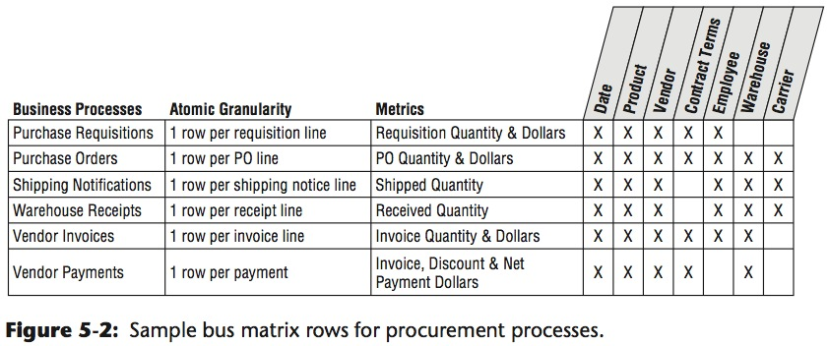
Q:How do you document this? A: Enterprise Bus Matrix
A key deliverable from requirements gathering, the bus matrix documents your business processes, facts and dimensions across all projects in your program.
Conformed dimensions
Notes:
For example the sales forecasting business process requires the following dimensions.

Slide 29
Group Activity: Bus Matrix
TODO:
Identify the business processes, facts and dimensions for your group’s business process.
Your prof will create an enterprise bus matrix based on the entire program.
Identify Business Processes
Transaction
Periodic Snapshot
Accumulating Snapshot
Identify Facts of the business process
Should be Additive, or at least Semi-Additive
Identify the dimensions used by the business process

Slide 30
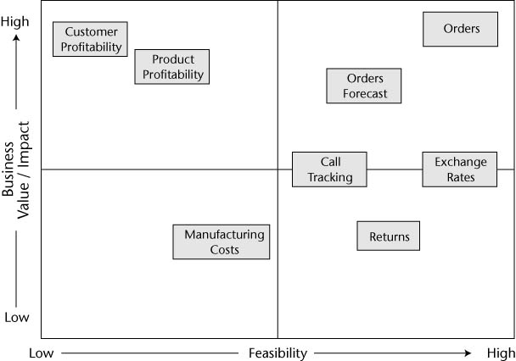
Prioritization Grid
Notes:
The prioritization grid is a useful tool to help determine the value of the projects associated with a program. You want to find the “low hanging fruit”: Highly feasible and high value projects. In this example that would be orders. Of course you can imagine there are a lot of variables and factors which are part of this kind of prioritization. Feasibility might be easy to determine based on technology and source data but business value can be subjective in nature. Sometimes what makes for a high value project is one with the strongest advocate or might affect the largest number of users.

Slide 31
Requirements Analysis Checklist
Identify each Business Processes with fact grain type.
Transaction
Periodic Snapshot
Accumulating Snapshot
Identify the facts and dimensions of each business process.
Create an Enterprise Bus Matrix –
Outline which dimensions go with which facts.
Should be based on the data you have (profiling)
Create a Bubble Chart –
Depicts which dimensions are used by which business processes (facts).
Create a Prioritization Grid –
Establish priority for each business process.

Slide 32
In Summary
The initial phases of the Kimball Lifecycle are project planning and requirements analysis.
First your organization must assess its readiness to take on the project.
In the project planning phase you should establish the project charter and assemble the team.
In the requirements phase you should interview business users, conduct data audits, and write up documentation.
You documentation should include an enterprise bus matrix to layout business processes & conformed dimensions and a prioritization grid high-value targets.

